Slide 1
The Equivalent Point Load via Composite Parts
Dr. Jacob Moore
Associate Professor of Engineering
Penn State Mont Alto

Slide 2
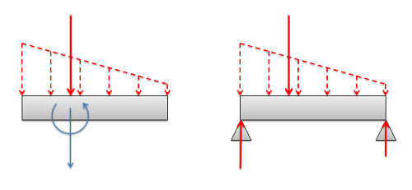
The Equivalent Point Load
The equivalent point load is a single point force that is statically equivalent to some original distributed force.
It would cause the same acceleration and angular acceleration as the original distributed force
It would cause the same reaction forces as the original distributed force

Slide 3
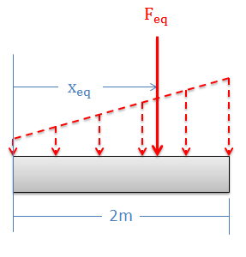
The Equivalent Point Load via Composite Parts
As an alternative to using integrals, we can also use the method of composite parts to find the magnitude and position of the equivalent point load.
This will be a geometry-based solution, rather than calculus-based solution.

Slide 4
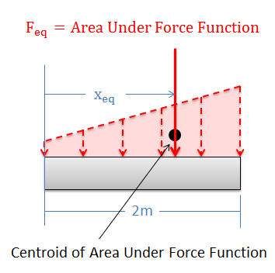
The Equivalent Point Load via Composite Parts
As we stated before, the magnitude of the equivalent point load (F_{eq}) will be the area under the force function.
The widths will be in units of distance
The heights will be in units of force per distance
The overall area will be a unit of force (Newtons, pounds, etc.)

Slide 5
The Equivalent Point Load via Composite Parts
The position (x_{eq}) can be determined by knowing that the equivalent point load will always travel through the centroid of the shape under the force function.
See Appendix 2 for more on finding the centroid of a shape.
You only really need to find the x position of the centroid

Slide 6
The Equivalent Point Load via Composite Parts in Surface Forces
As we jump to surface forces…
The magnitude of the equivalent point load is just the volume under the force function.
The equivalent point load will always travel through the centroid of the volume under the force function.
You will need to find two of the three coordinates of the centroid.
F_{eq} = Volume under Force Function
Centroid of Volume Under Force Function

Slide 7
Thanks for Watching
See other engineering mechanics videos and access the full tool at…

Slide 8
Equivalent Point Load Worked Example Problem
Determine the magnitude and location of the equivalent point load for the distributed force shown below using composite parts.
15 kN/m
2 m
3 m
3 m

Slide 9
Equivalent Point Load Worked Example Problem
Use composite parts to identify the magnitude and location of the equivalent point load, then use that to identify the reaction forces at supports A and B, which are each 1 ft from the edge of the beam.
60 lbs/ft
40 lbs/ft
A
B
2 ft
2 ft
6 ft

